Slide 1



http://csaladen.es/present
Energy
Transitions
U
h ow
energy
a ctively
d rives our
s ociety and
u niversal
p olitics
Dénes Csala
Lecturer in Energy Storage Systems Dynamics

Slide 2
« 2 ÷ 20 »
Energy
Transitions
1
Climate Change
2
Complexity
3
Transitions
Renewables
5
6
Trilemma
Challenges
4
1
h ow
energy
a ctively
d rives our
s ociety and
u niversal
p olitics
Lancaster
09/12/2016

Slide 3
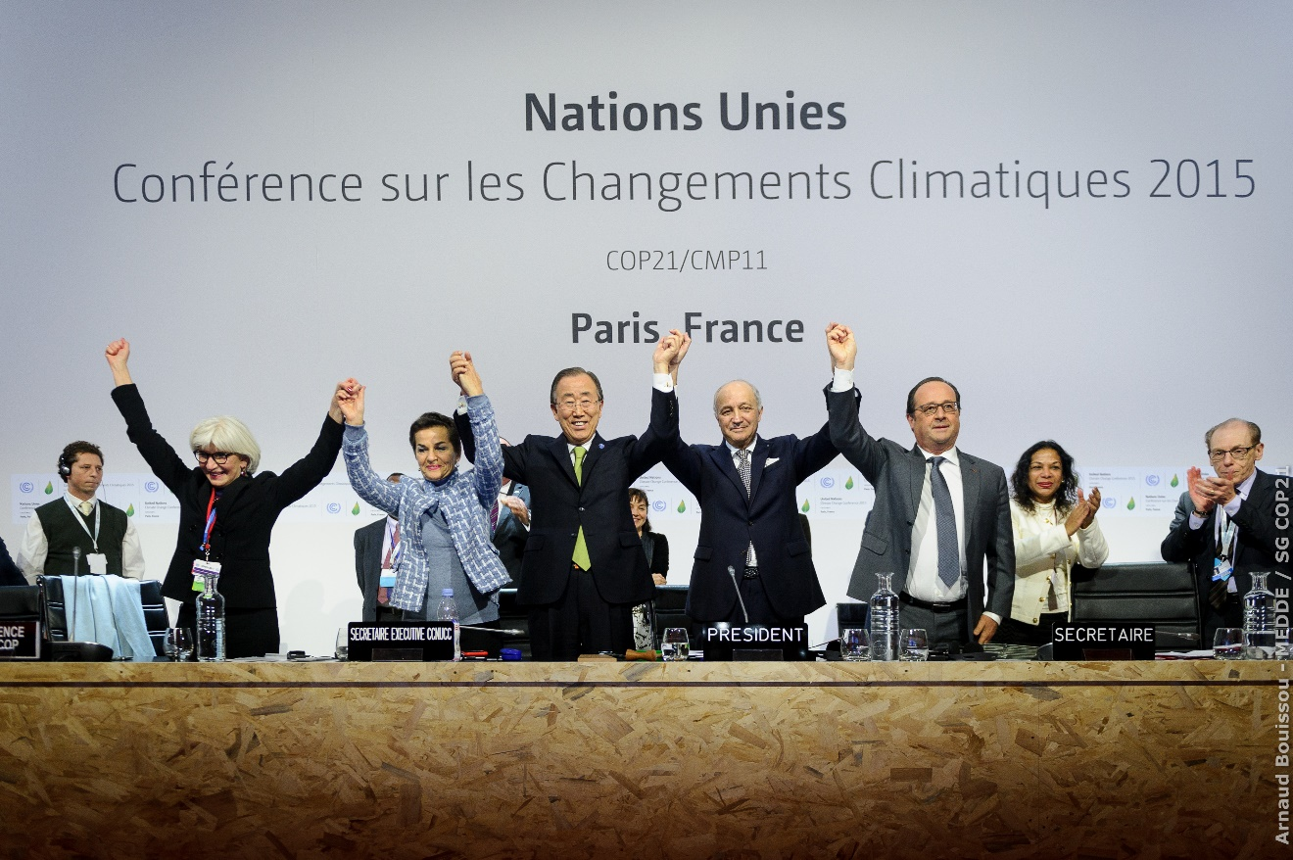

« 3 ÷ 20 »
Energy
Transitions
1
Climate Change
2
Complexity
3
Transitions
Renewables
5
6
Trilemma
Challenges
4
1
Lancaster
09/12/2016
Notes:
My sort of overarching academic goal currently is to contribute to the global climate change discussion.
Historic event last year, the Paris Climate Agreement, but what is even more historic is China and the US pledging to sign it. A couple of days ago.
There is actually a conference going on right now in Oxford ECI about meeting the 1.5 targets, but the INDC’s take us to 3.5.
Since energy is very interrelated with climate change and the main source of emissions by far, I am taking a new, energy-based angle, by treating growth processes not as something governed by the paws of economics but rather than by the laws and limits of physics
science paper 1968 garett hardin on pollution, also gaming approach as tragedy of the commons or a multiplayer prisoners dilemma

Slide 4
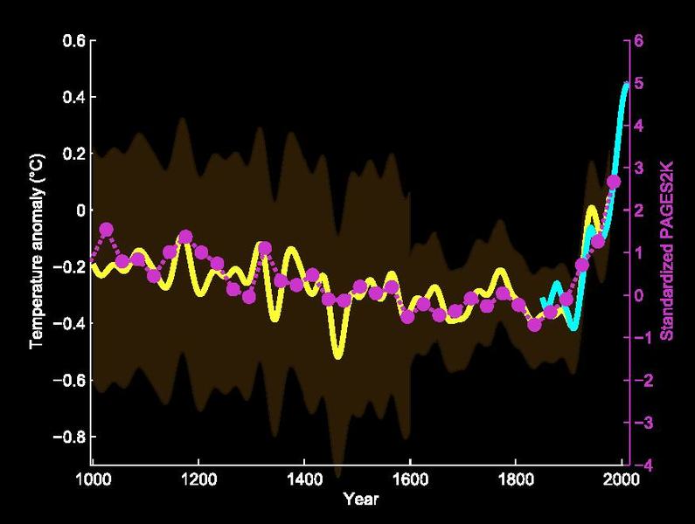



climate change discussion
« 4 ÷ 20 »
Energy
Transitions
1
Climate Change
2
Complexity
3
Transitions
Renewables
5
6
Trilemma
Challenges
4
1
Mann et al 1999
Lancaster
09/12/2016
Notes:
WMO -1966 create notion for climate phenomena longer than 10 years
Mann, Bradley & Hughes 1999

Slide 5
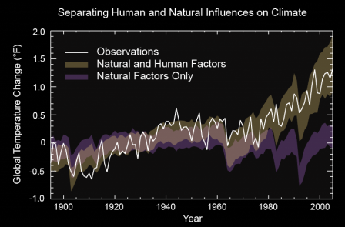
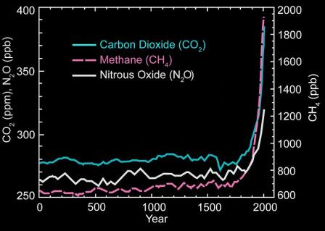
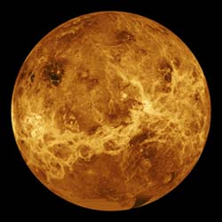
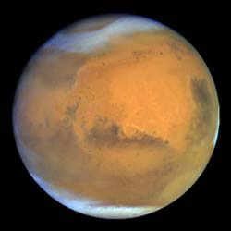
reasons for climate change
« 5 ÷ 20 »
Energy
Transitions
1
Climate Change
2
Complexity
3
Transitions
Renewables
5
6
Trilemma
Challenges
4
1
EPA, NASA
Lancaster
09/12/2016
Notes:
Variations in the sun's energy reaching Earth
Changes in the reflectivity of Earth’s atmosphere and surface
Changes in the greenhouse effect, which affects the amount of heat retained by Earth’s atmosphere – this is a very delicate balance

Slide 6
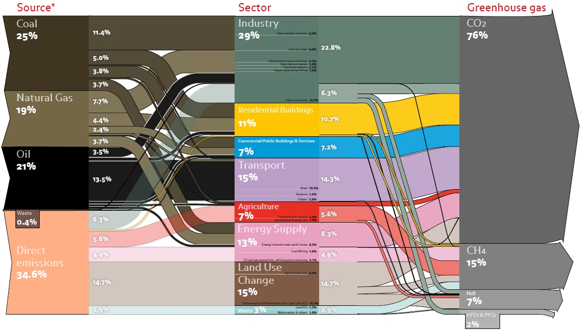
emissions
« 6 ÷ 20 »
Energy
Transitions
1
Climate Change
2
Complexity
3
Transitions
Renewables
5
6
Trilemma
Challenges
4
1
ECOFYS 2010
Lancaster
20/09/2016
Notes:
ECOFYS, 2010

Slide 7
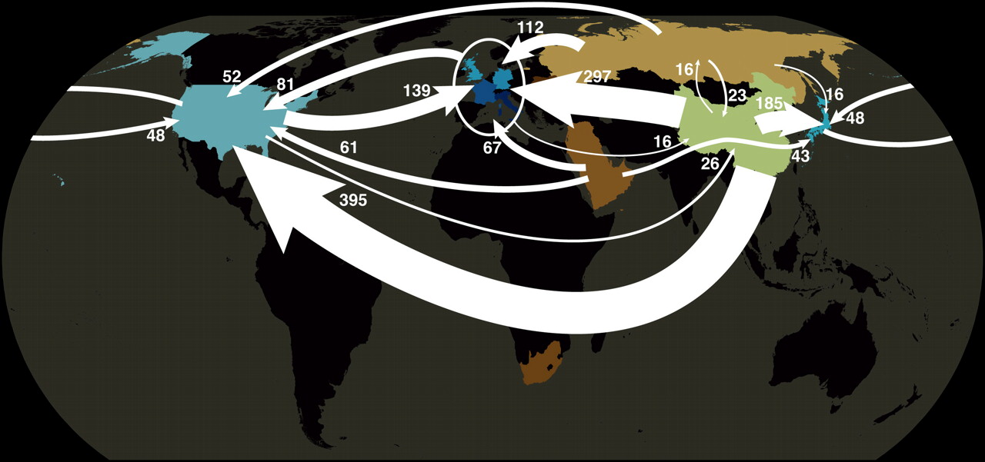
emissions distribution
« 7 ÷ 20 »
Dénes Csala
faculty candidate
1
Climate Change
2
Complexity
3
Transitions
Renewables
5
6
Trilemma
Challenges
4
1
2
Davis & Caldeira, 2009
Lancaster
09/12/2016
Notes:
Emissions distributions is a tricky thing
Need to cater for developing countries

Slide 8
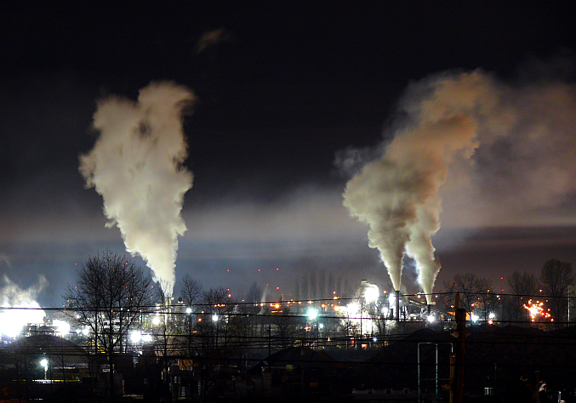
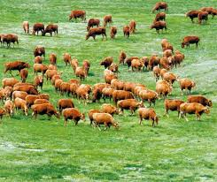
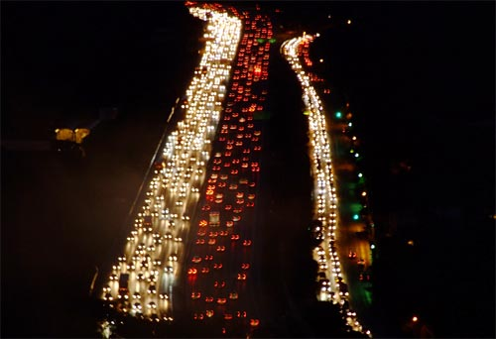
tragedy of the commons
« 8 ÷ 20 »
Energy
Transitions
1
Climate Change
2
Complexity
3
Transitions
Renewables
5
6
Trilemma
Challenges
4
2
Lancaster
09/12/2016
Notes:
William Forster Lloyd, 1833
Garett Hardin, 1968, Science, ToC revisited

Slide 9
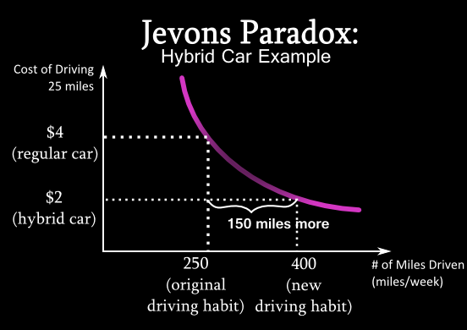
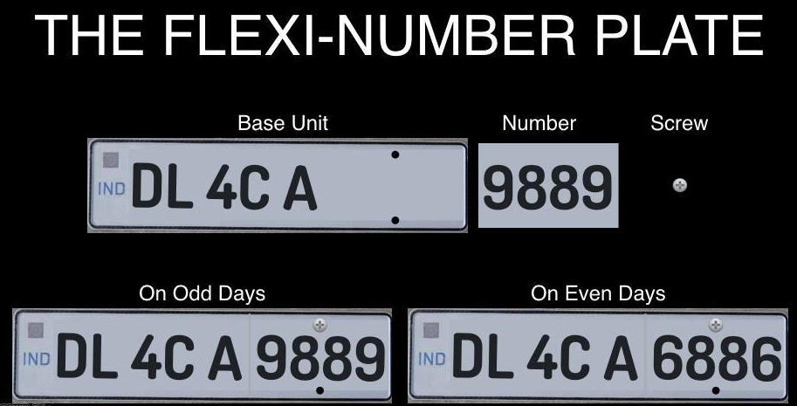
rebound effect
« 9 ÷ 20 »
Energy
Transitions
1
Climate Change
2
Complexity
3
Transitions
Renewables
5
6
Trilemma
Challenges
4
2
Lancaster
09/12/2016
Notes:
OK you can say that efficiency will save us, costs are dropping
Enter: Jevon’s paradox – as things get cheaper, we tend to use more of them
Tell LA example of reducing emission
Then show example from Delhi

Slide 10
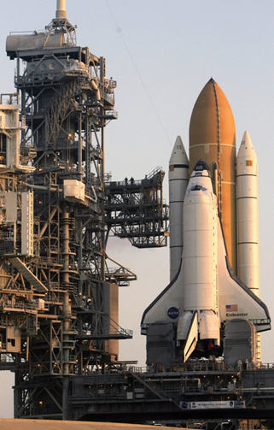
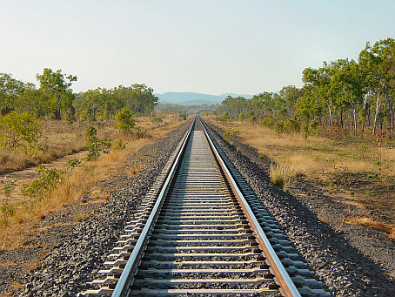
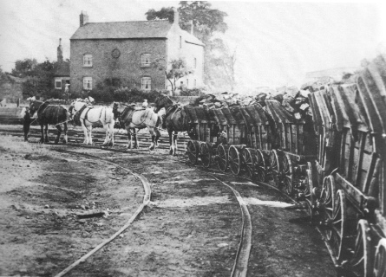
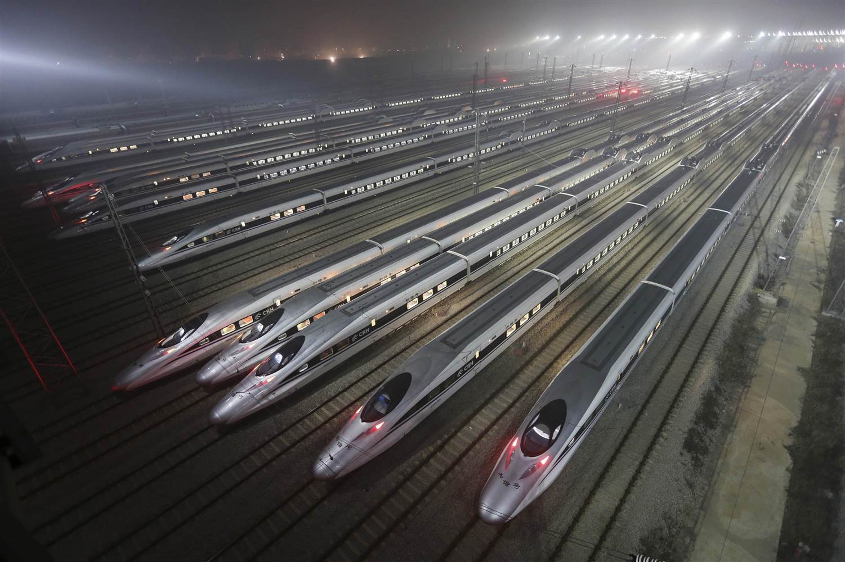
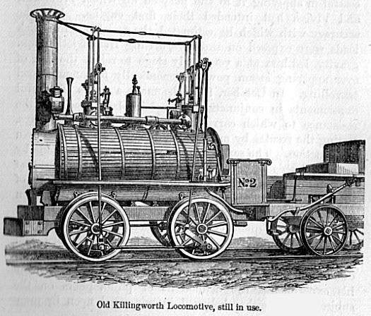
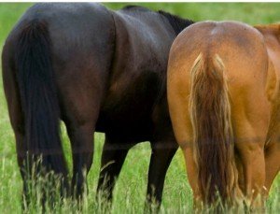
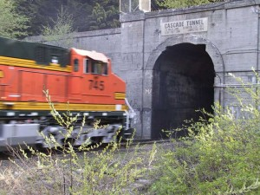
stranded assets and the lock-in effect
« 10 ÷ 20 »
Energy
Transitions
1
Climate Change
2
Complexity
3
Transitions
Renewables
5
6
Trilemma
Challenges
4
2
Lancaster
09/12/2016
Notes:
Lock-in
First Liv-Man line, frist intercity line in the world
Originally created carts for horse to take the coal out of the mines, easier tracktion.
http://thefrogandpenguinn.blogspot.co.uk/2011/05/update-on-two-horses-asses.html

Slide 11
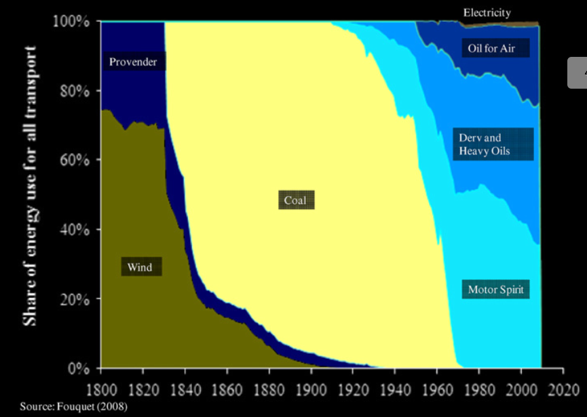
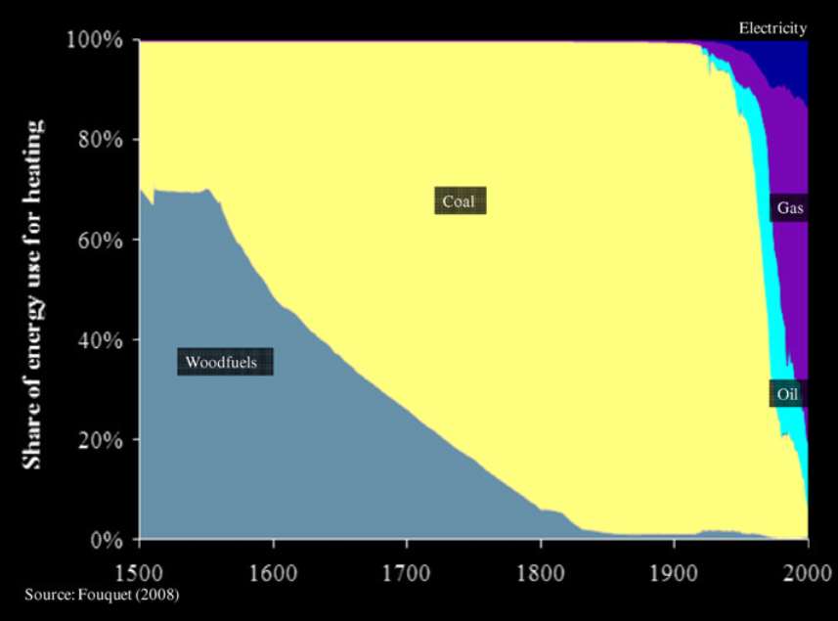
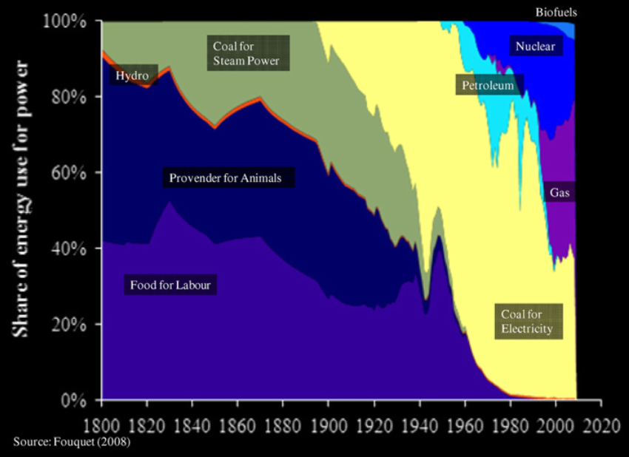
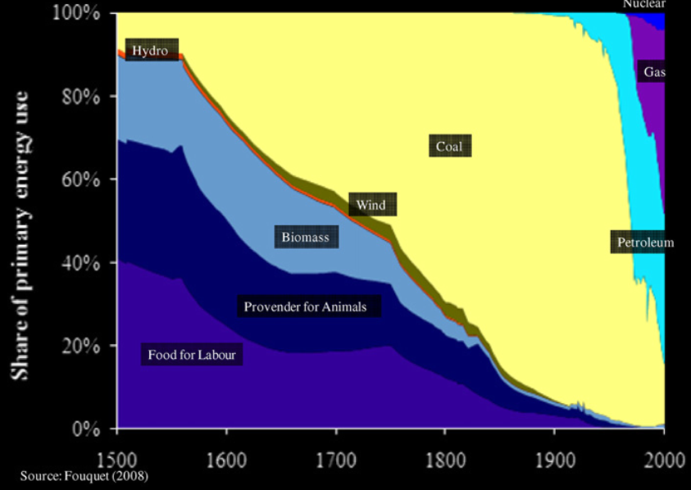
past energy transitions
« 11 ÷ 20 »
Energy
Transitions
1
Climate Change
2
Complexity
3
Transitions
Renewables
5
6
Trilemma
Challenges
4
2
3
Lancaster
09/12/2016
Notes:
Fouquet (2008)
Energy Transitions take time – but they are speeding up.
The problem with fossil fuels

Slide 12
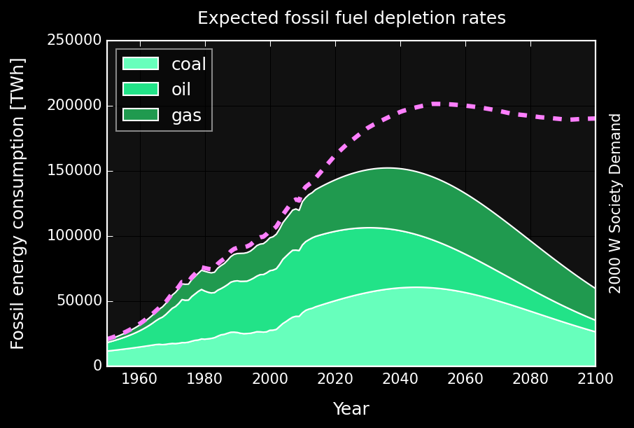
Carbon budget* 990 GtCO2
Hubbert curve
« 12 ÷ 20 »
Energy
Transitions
1
Climate Change
2
Complexity
3
Transitions
Renewables
5
6
Trilemma
Challenges
4
3
Csala, 2014
Lancaster
09/12/2016
Notes:
M King Hubbert 1956 – he pridcted that US oil would peak around 1970 – it was actually very spot on – for conventional oil
So we need to speed up the transition much faster than historical examples

Slide 13
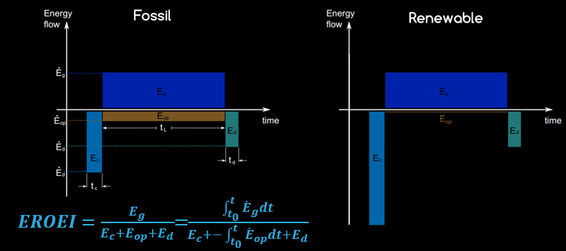
energy return on energy investment
« 13 ÷ 20 »
Energy
Transitions
1
Climate Change
2
Complexity
3
Transitions
Renewables
5
6
Trilemma
Challenges
4
3
4
Murphy et al 2011
Csala, 2016
Lancaster
09/12/2016
Notes:
However this is not so easy, since eroei

Slide 14
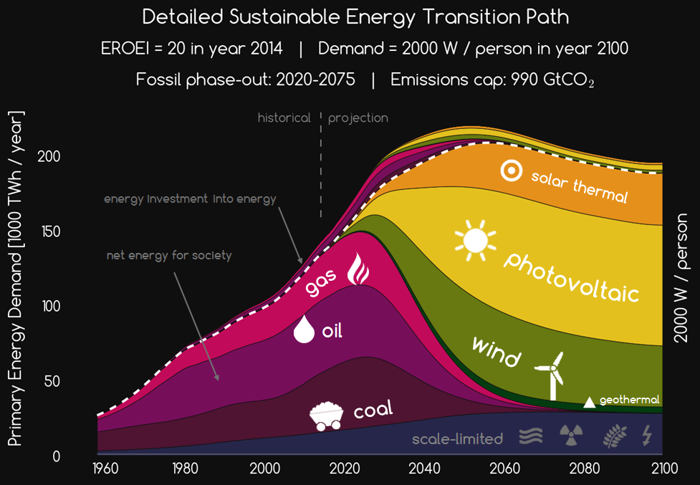
« 14 ÷ 20 »
Energy
Transitions
1
Climate Change
2
Complexity
3
Transitions
Renewables
5
6
Trilemma
Challenges
4
4
Sgouridis, Csala, Bardi
2014, 2016
Lancaster
09/12/2016
Notes:
Massive, two orders of magnitude investment scale-up is needed

Slide 15
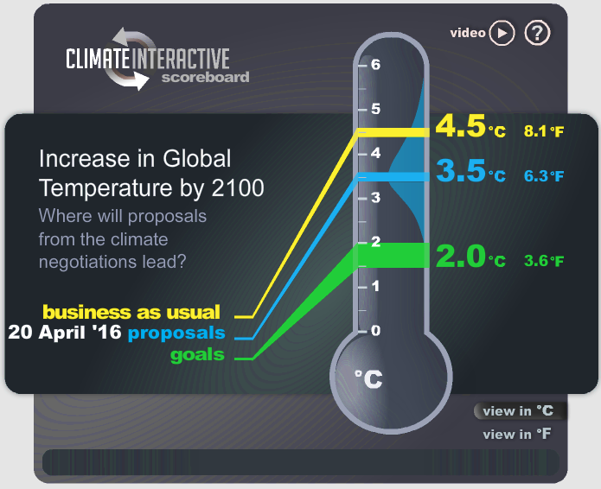
current mechanism
« 15 ÷ 20 »
Energy
Transitions
1
Climate Change
2
Complexity
3
Transitions
Renewables
5
6
Trilemma
Challenges
4
4
5
Climate Interactive, 2016
Lancaster
09/12/2016
Notes:
INDC,
Accountability,
Developing nations want to emit

Slide 16
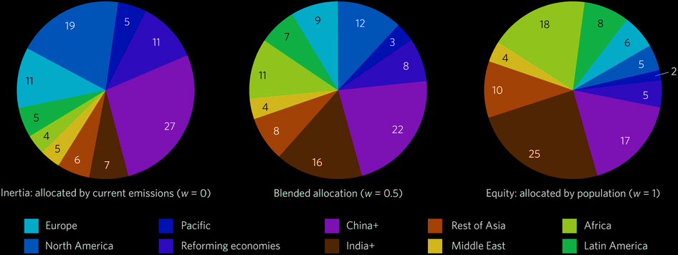
emissions quotas
« 16 ÷ 20 »
Energy
Transitions
1
Climate Change
2
Complexity
3
Transitions
Renewables
5
6
Trilemma
Challenges
4
5
Raupach et al, 2014
Lancaster
09/12/2016
Notes:
Population based,
Gdp base, consumption - productions based
Stock based, rate based

Slide 17
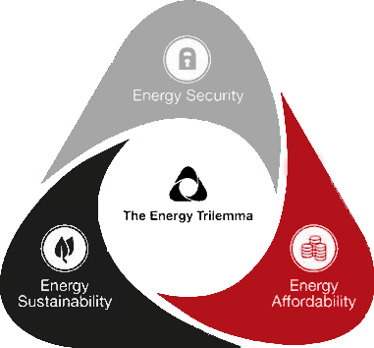
energy trilemma
« 17 ÷ 20 »
Energy
Transitions
1
Climate Change
2
Complexity
3
Transitions
Renewables
5
6
Trilemma
Challenges
4
5
6
Climate Interactive, 2016
Lancaster
09/12/2016
Notes:
On top of the transitiosn to renewables we also have the energy trilemma problem

Slide 18
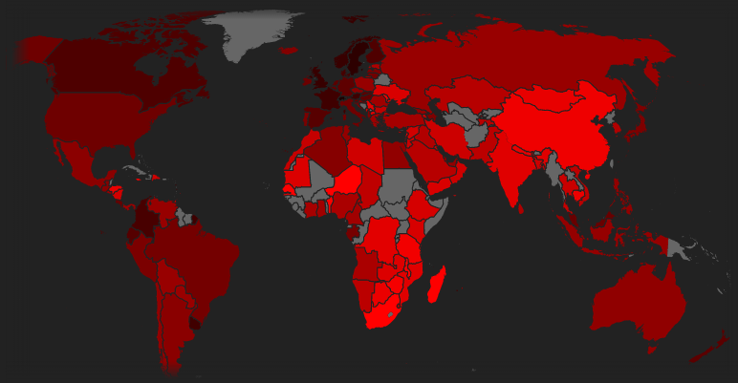
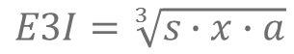
« 18 ÷ 20 »
Energy Trilemma Index
geometric mean of the component scores
Energy
Transitions
1
Climate Change
2
Complexity
3
Transitions
Renewables
5
6
Trilemma
Challenges
4
$$E3I=\sqrt[3]{s∙x∙a}$$
6
0 10
data: WECC
graph: own
2015
Lancaster
09/12/2016
Notes:
If we take the geometric mean of these grades and plot the on a world map this is what we get, where we can clearly see some correlation between economic wealth and the average of the E3I.

Slide 19
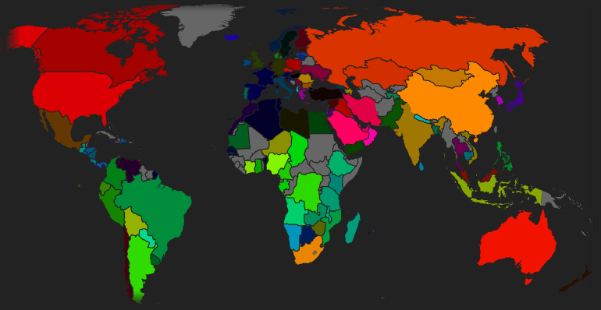
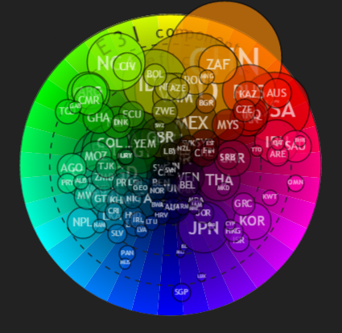

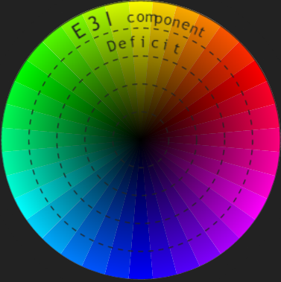
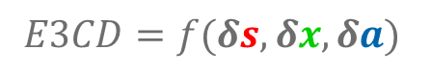
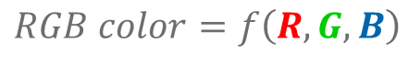
« 19 ÷ 20 »
Energy Trilemma Component Deficit
deviation from mean of each component
Energy
Transitions
storage
1
Climate Change
2
Complexity
3
Transitions
Renewables
5
6
Trilemma
Challenges
4
security
affordability
sustainability
$$RGB color=f\left(R,G,B\right)$$
$E3CD=f(δs,δx,δa)$
6
data: WECC
graph: own
2015
Lancaster
09/12/2016
Notes:
However what is more interesting to look at the component deficit: e.g. the deviation from mean of each component.
We will do this using a concept of a color wheel. Every color on the screen is displayed as a mixture of three numbers of saturation, R,G,B.
Let u replace the R,G,B with the deviation from the geometric mean of the energy trilemma index of each component, sustainability, security and affordability.
Then attach a color to each of these on components the color wheel. Then each of the countries will get a color, based on the values of their components.
On the color wheel the further from the center a point is the greater is the imbalance in that component. Bubble sizes correspond to population in this graph. What we can see that most of the countries are in the red, while south American and African countries are in the green. This means that relatively to each other, sustainability is the biggest problem of energy today, followed by security and by far ahead of affordability – only a mild problem in some European countries, with stable and sustainable grids such as France or Iceland or Switzerland or in Japan.
If we want to solve the sustainability component in future energy systems we will have a high penetration of renewables, which will compromise on the security of supply. Storage links these components together – and is also affects affordability.

Slide 20




























« 20 ÷ 20 »
Lancaster University
United Kingdom
Energy
Transitions
1
Climate Change
2
Complexity
3
Transitions
Renewables
5
6
Trilemma
Challenges
4
Worldwide
Europe
6
Lancaster
09/12/2016
Notes:
Some useful partners doing energy transitions research

Slide 21

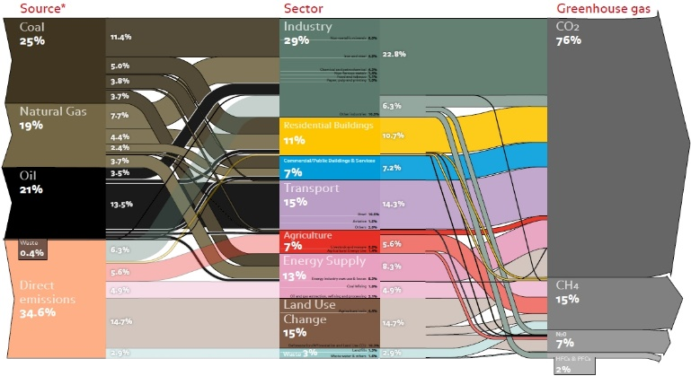
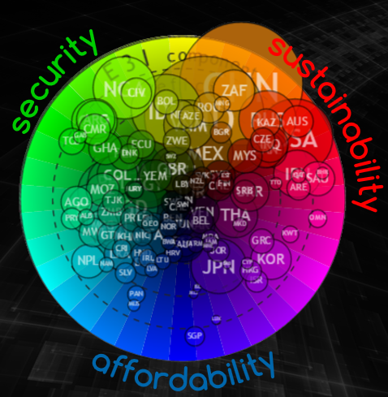
Energy
Transitions
1
Climate Change
2
Complexity
3
Transitions
Renewables
5
6
Challenges
4
Trilemma
recap
Lancaster
09/12/2016
Notes:
Remember:
-the organizations
-Earth’s gases are in a delicate balance
-emission mostly come from energy
-hard to distribute because of trade and past
-stranded assets and lock-in effects make it even harder
-transitions also take time, especially for renewables

Slide 22
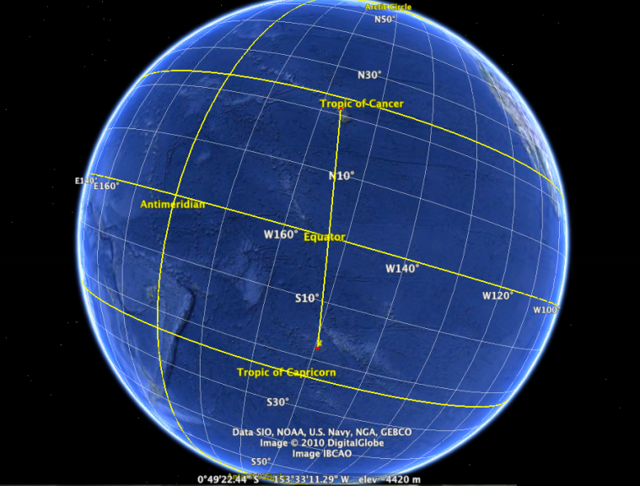

“Look beyond the horizon, so that you can see the island you are going to. Especially because you have never been there, you have to see that island in your mind, or else you can never get there…”
Mau Pilaung (Polynesian master navigator) to Nainoa Thompson (first Hawaiian to repeat the voyage) – adapted from Sgouris Sgouridis
Notes:
Polynesian sailors have rouotinely navigated 4000 kilometers, from Tahiti to Hawaii, without any western instrments for survival

Slide 23
Energy
Transitions
http://csaladen.es
thank you

